Slide 1


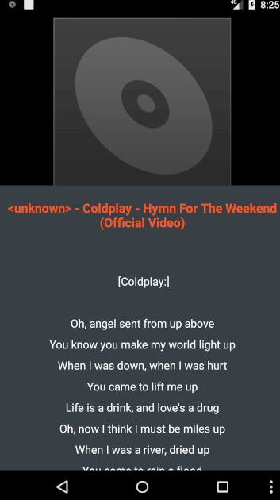
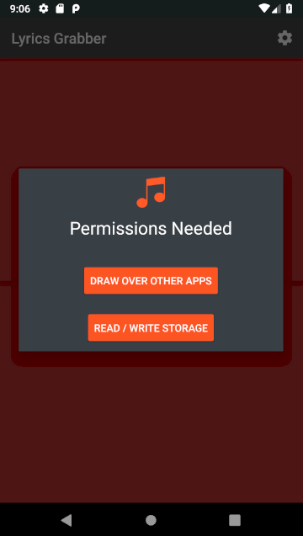


Student Evaluation
Raj Kumar Rai
BSc (Hons) in Information Technology– NP3F1801IT
Introduction
Music plays an important role in the socialization of children, adolescents, and adult. Popular music is present almost everywhere, and it is easily available through the radio, various recordings, the Internet, and new technologies, allowing adolescents to hear it in diverse settings and situations, alone or shared with friends.
And this project is about to get Lyrics of songs “LYRICS GRABBER”. It is the application which helps to generate the lyrics of a song. The project title refers the whole meaning of the entire project. (Lyrics grabber) it is a kind of app which grabs the lyrics of the song and provides to user. This app is best for the music lover and artists who are enrolled in the music field its main target is to reduce effort for the people who are fond of music.
Nepal is an underdeveloped landlocked country from south Asia. Unstable political situation is the major problem of the backwardness of the country. Recently in Nepal there has not been any progress in music industry. Nepal is full of different culture and religion and the society, culture has their own musical influence some famous music instrument of country were Sarangi, Madal.
Technology Used to implement Student Evaluation
System Feature
Grab songs in play list
Shows the lyrics of the song while playing
Can be used from notification bar
Can download lyrics of the song
Can be used over another app
Lyrics Grabber is develop by using android studio and java.
Objective
Conclusion
To get lyrics of the song
To make easy to get lyrics of the song
Easy to use
Can be taken anywhere
The research generates various ideas to implement for the future enhancements to tackle and overcome the conflicts occurred previously. However, it was managed to gain the sufficient technical comparisons that emitted that comprehensive understanding to support idea with its development phase. The awareness of the developer regarding the proposed system consciously increased, hence it is a benefit due to this and impact will be positively rendered to the system.
To finished the report the developer have to write huge proposed system required huge extensible notes with an appropriate different study about cases however it know that the search of the study will helped the developer in building the future informative plans. The research generates various ideas to implement for the future enhancements to tackle and overcome the conflicts occurred previously. However, it was managed to gain the sufficient technical comparisons that emitted that comprehensive understanding to support idea with its development phase. The awareness of the developer regarding the proposed system consciously increased, hence it is a benefit due to this and impact will be positively rendered to the system.
Screenshot of Student Evaluation Home Page
Screenshot of Timetable Page
Hardware and Software Requirement Specification
Student Evaluation System
Developed by: Laxman Ghalan
NP000036
BSc (Hons) in Information Technology
Intake Code: NP3F1801IT
Supervised by: Sagun Dhungana
Student Evaluation system is only support for the devices and software version as shown below.
Above Windows 10
Above SQL Server 2014
Above Visual Studio 2013
RAM 4 GB
HDD 320 GB

